Slide 1
Global Retail Solutions Jayashree Nagaraju
Notes:
Hello all,
Today I’m going to present about a made-up company called global retail solutions
Welcome to the analysis of Global retail solutions.

Slide 2

Project analysis slide 2
Company Background
Leading retailer specializing in a wide range of consumer goods
Located in Multiple continents
Products and Services
Offers a comprehensive selection of products including electronics, home appliances, fashion apparel, books and groceries
Business Statement
Identify the most popular brand and category to provide meaningful insights to the marketing and sales department to attract more customers
Notes:
Coming to project scope.
The company is a leading online retailer with presence in many countries which specializes in selling a wide range of consumer goods.
And offers a huge variety of selection of products including electronics, home appliances, fashion, apparel and books.
The business statement is to identify the most popular brand and category to provide meaningful insights to the marketing and sales department to attract more customers.

Slide 3

Project analysis slide 2
Dataset Overview
Dataset
Dataset from Kaggle
Almost 300K records
Data of 2 years (2022 & 2023)
Description
Customer Information
Transaction Details
Product Information
Geographic Information
Notes:
I found this dataset from Kaggle which had almost 300K records over two years, 2022 and 2023.
It has information related to customers, their transactions, the products they bought and their geographic information.

Slide 4
Project analysis slide 2
Tools Used
Python
For data cleaning and
creating separate
data frames for normalisation
SQL
for creating ERD diagrams
and further analysis
Tableau
for visualisation
Notes:
I used Python for data cleaning, by creating separate data frames to make it easy for normalization.
#To have a cleaned data, I renamed the column names ,Removed null values and duplicate entries , and fixed the datatype to ensure consistency and usability for analysis.
Later load the data to SQL database for further analysis and to create ERD diagrams.
I also used Tableau for visualization and created dashboards for sales and marketing team and a dashboard about customer insights.

Slide 5
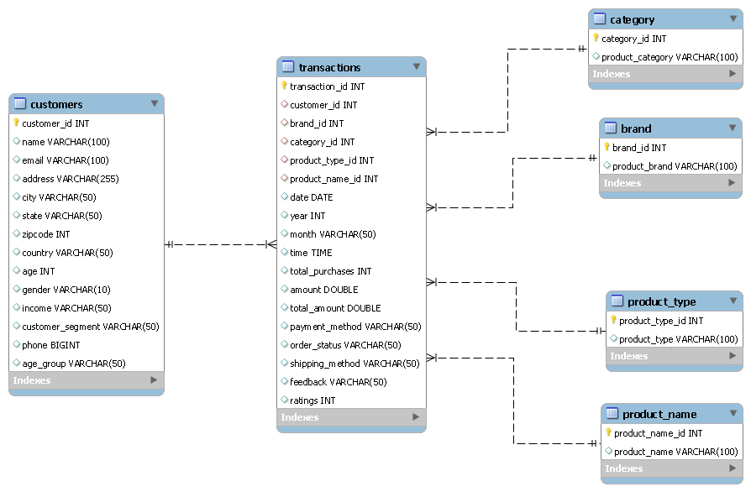
Project analysis slide 2
ERD Diagram
Notes:
Here we can see the visual representation of the relationships between different entities
after I separated the dataset into smaller, more manageable data frames with proper data normalisation of SQL.

Slide 6
Project analysis slide 2
Business Cases
Customer segmentation analysis based on age, gender, income etc.
Sales trend analysis over time to identify peak seasons or trends.
Product performance analysis to determine popular categories, brand and type.
Geographic analysis to understand regional preferences.
Notes:
For business cases I have tried to answer
Customer segmentation analysis based on age, gender, income and other criteria's.
Along with Sales trend analysis over time to identify peak seasons or trends.
Including Product performance analysis to determine popular categories, brand and type.
And Geographic analysis to understand regional preferences
How can the business effectively segment its customer base and optimize products, services, and
operations based on customer demographics, preferences, and feedback, to improve customer satisfaction and retention,
and identify potential regions for market expansion?
How can we analyze and understand our total revenue, customer distribution,
and trends across different geographic regions, customer segments, and demographic factors over time?
How to effectively allocate marketing resources and optimize sales strategies across
different countries, brands, product types, and categories to maximize revenue.

Slide 7
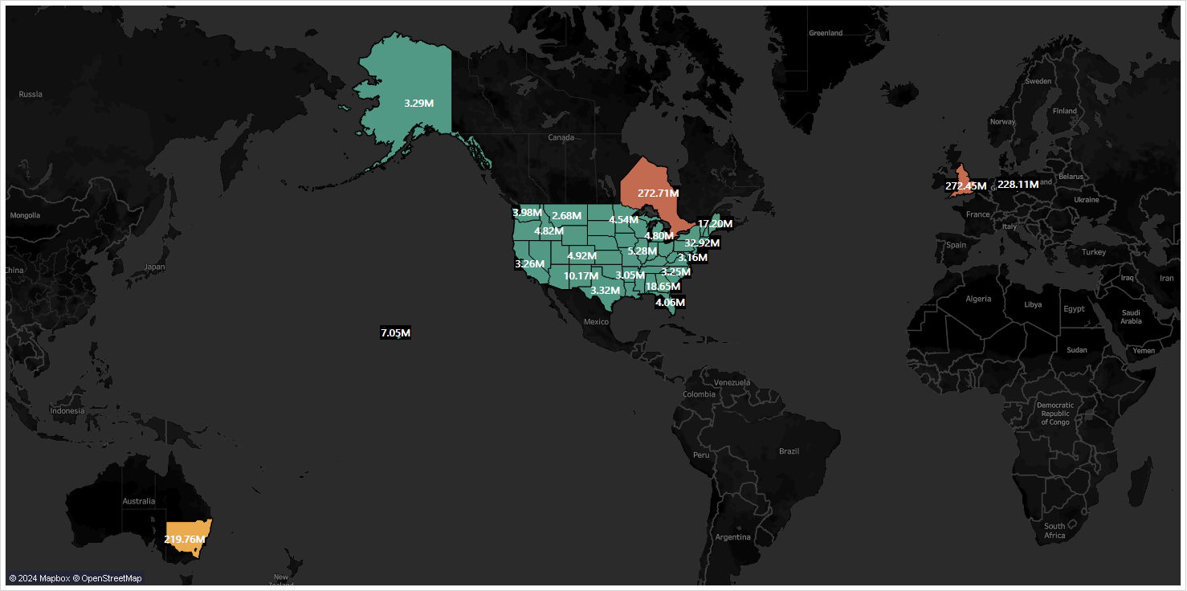
Project analysis slide 2
Tableau Visualizations
Click on the above image to visit tableau public
Notes:
Now let us see the tableau dashboard visualisations which would help us in visualizing the data for better understanding and solving the problems. [go to tableau]

Slide 8

Project analysis slide 2
Major Obstacle
Missing fields
Profit calculation
Unsupervised learning (ML)
Dataset too big for clustering
Notes:
Coming to obstacle part ,The dataset has no information related to product cost and selling price to know the actual profit.
I wanted to explore various ML techniques, so I used clustering algorithms, to discover interesting patterns in data, such as groups of customers based on their behaviour.
Due to the size of the data the calculation took a huge amount of time, so I couldn't get the results with ML technique.

Slide 9

Project analysis slide 2
Conclusion
Targeted marketing campaigns
Product recommendations
Loyalty programs for frequent buyers
Inventory management
Notes:
So, the suggestions we can give from this analysis for the marketing team is to send targeted marketing emails to high value customers for high revenue products, also focussing on different customer groups based on their behaviours and focus on frequent shoppers and have them in loyalty programs
Since we also know which products are being sold more often it helps the team to keep up with the inventory.

Slide 10
Thank You
Notes:
That’s it from my end .Thank you very much for listening and a special thanks to Ignacio and Simi for helping me understand about unsupervised learning ML concepts.

